Slide 1




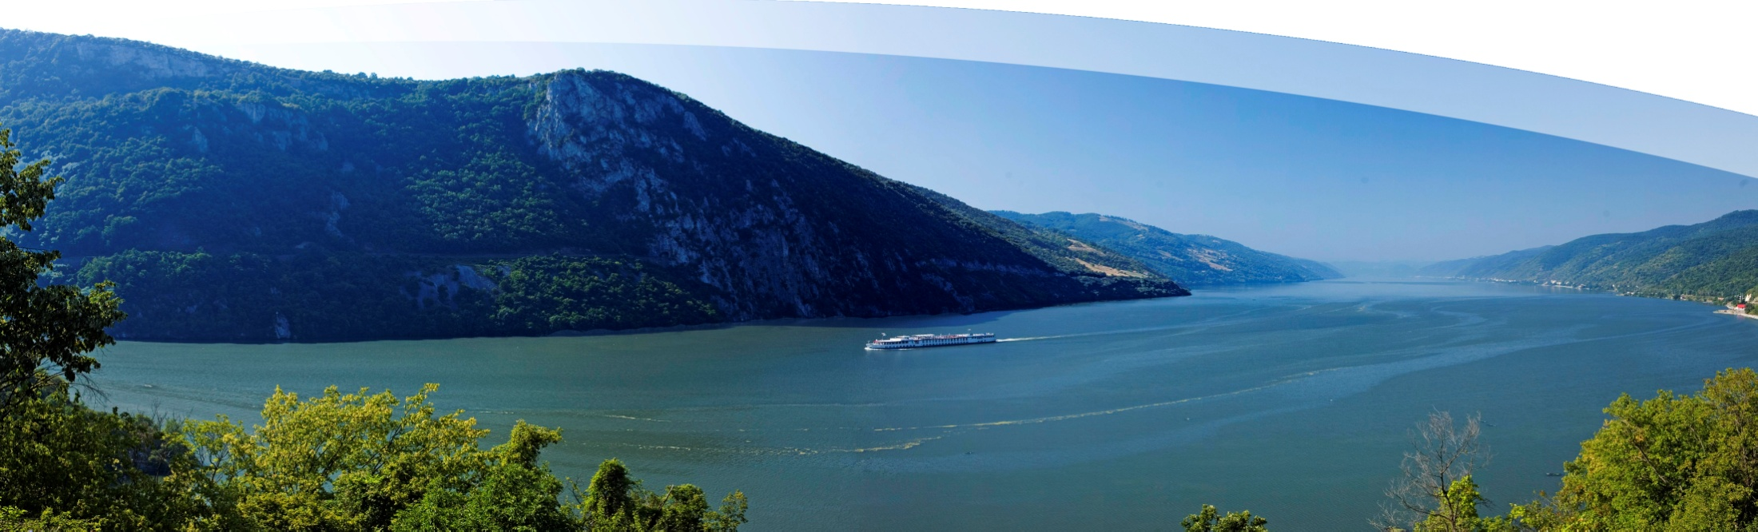
Unlocking Benefits of PUBLIC PARTICIPATION in decision-making
Rudolf Schicker, PAC 10 EUSDR, Vienna
EUROPEAN UNION
11th June 2018, Vienna

Slide 2
EUROPEAN UNION
European Strategy for the Danube Region,
PA 10 – capacity building and cooperation;
Danube Participation Days and the Agenda for Participation;
Participation in the City of Vienna;
Remarks to the Recommendations

Slide 3

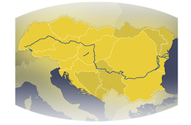
Countries Participation
14 countries
9 EU-members
5 non members
>110 Mio. inhabitants
EU STRATEGY FOR
THE DANUBE REGION (EUSDR)
www.danube-region.eu

Slide 4
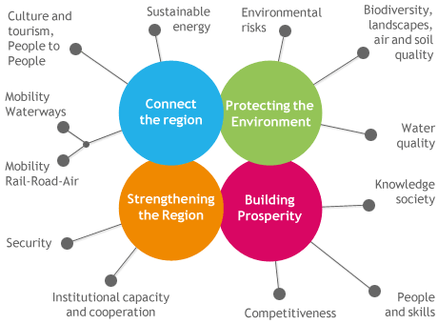
Actionplan
European
Commission,
European Council,
European Parliament
EESC & CoR

Slide 5
Priority Area 10 is part of Pillar 4 „Strengthening the Region“
EU STRATEGY FOR THE DANUBE REGION (EUSDR) | www.danube-region.eu

Slide 6
Cooperation and capacity-building are the keys to
better living conditions in the Danube Region
Public management practices
Cooperative structures catching the needs of citizens
Political and/or administrative reforms to build a smart, sustainable and inclusive Danube Region
Involvement of civil society
Strengthening governance through inclusion of stakeholders
Unfold urban and regional potentials
Foster territorial, social and economic cohesion
EU STRATEGY FOR THE DANUBE REGION (EUSDR) | www.danube-region.eu

Slide 7
Cooperation and capacity-building are the keys to
better living conditions in the Danube Region
Public management practices
Cooperative structures catching the needs of citizens
Political and/or administrative reforms to build a smart, sustainable and inclusive Danube Region
Involvement of civil society
Strengthening governance through inclusion of stakeholders
Unfold urban and regional potentials
Foster territorial, social and economic cohesion
EU STRATEGY FOR THE DANUBE REGION (EUSDR) | www.danube-region.eu

Slide 8
EUROPEAN UNION
Civil Society in the Danube Region
- One Opinion Groups
- Non Governmental Organisations (NGOs)
- Voluntary Organisations
- Social Partners
Including CS in sound governance, decision taking and participaion processes

Slide 9
EUROPEAN UNION
Civil Society in the Danube Region
Danube Participation Days
National Participation Days
Danube Civil Society Forum
Agenda for Participation

Slide 10
EUROPEAN UNION
Civil Society in the Danube Region
Agenda for Participation - Participation Partnership
The Participation partnerships are transnational, open platforms with the aims:
Mobilize a broader range of local actors and NGOs
Involve partners from political and administrative level
Empower the interaction of relevant societal actors and oganisations
Thematical cooperation will lead to:
implementation of pilot projects,
round tables for disseminating information
Involving new groups of stakeholders
The Agenda networks act as steering group
for the partnerships

Slide 11
EUROPEAN UNION
Civil Society in the Danube Region
5th Danube Participation Day
16 th October 2018 in Sofia

Slide 12
EUROPEAN UNION
Participation in Vienna
Who are the benefitiers of participation processes?
The Public in generell?
Citizens?
Administration?
Politicians?
Economy?

Slide 13
EUROPEAN UNION
Participation in Vienna
What are the benefits, the value added?
Results fitting the citizens needs
Better results,
minimized potential conflicts
Rising acceptance
Strenghtening democratic processes

Slide 14
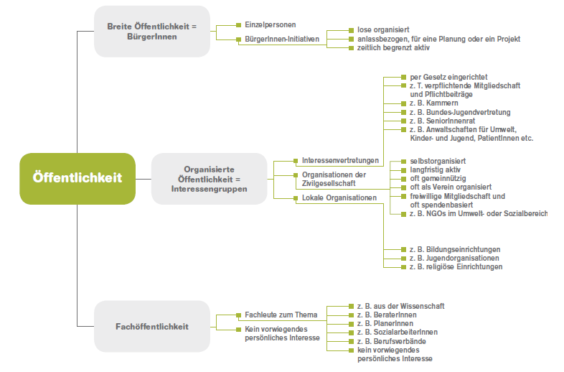
EUROPEAN UNION
Who is the Public?
Public administration
And enterprices
are not part of „the public“

Slide 15
EUROPEAN UNION
Participation processes involve
The public (citizens, relevant experts,civil society)
Administration
Enterprices
Politicians

Slide 16
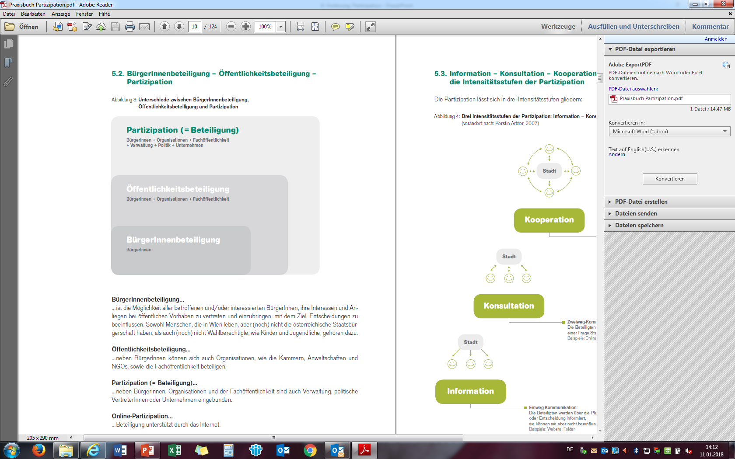
EUROPEAN UNION
Mulit-channel Communication:
Participants and Administration work together in a cooperative way
e.g. online-dialog, round table, ……
Two-way communication:
Participants make amandments to a draft
e.g. online questionnaire, public consultations
One-way communication:
Participants get informed about planned initiatives or decisions
e.g. web-sides, folders……

Slide 17
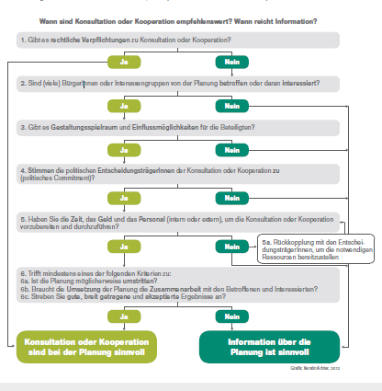
EUROPEAN UNION
How to decide?
Which way of involvement to choose?
Information
Consultation
Cooperation

Slide 18
EUROPEAN UNION
To do list:
Rules of participation (openness, constraints)
Realistic expectations
No unrealistic promises
Provide access to all relevant facts
Quick and precise answers
Written documentaion of the process
Encourage critical remarks/questions
- No cover-up of the real results (consensus, summary of discussion with dissent…)

Slide 19
EUROPEAN UNION
Ausstellung Ottakringer Straße Neu | Stadtspaziergang Nordwest Bahnhof | Aktivierende Befragung | Online Befragung
BürgerInnen Café Leitbild Kagran Zentrum | Öffentliches Planungsworkshop Planquadrat | Bau-Workshop | Online-Ideenplattform
World-Café Stadt-Umland Konferenz | Open Space | Zukunftswerkstatt Stuwerviertel Planungszelle Yppenplatz | Online-Dialog
Workshop Kabelwerk | Arbeitsgruppe Augustinplatz | Zukunftskonferenz Joe Zawinul-Platz
Runder Tisch | Grätzlbeirat Alliiertenviertel | Mediation Terminal Wien Inzersdorf Flughafen Wien
Different
Intensity
of
participation

Slide 20
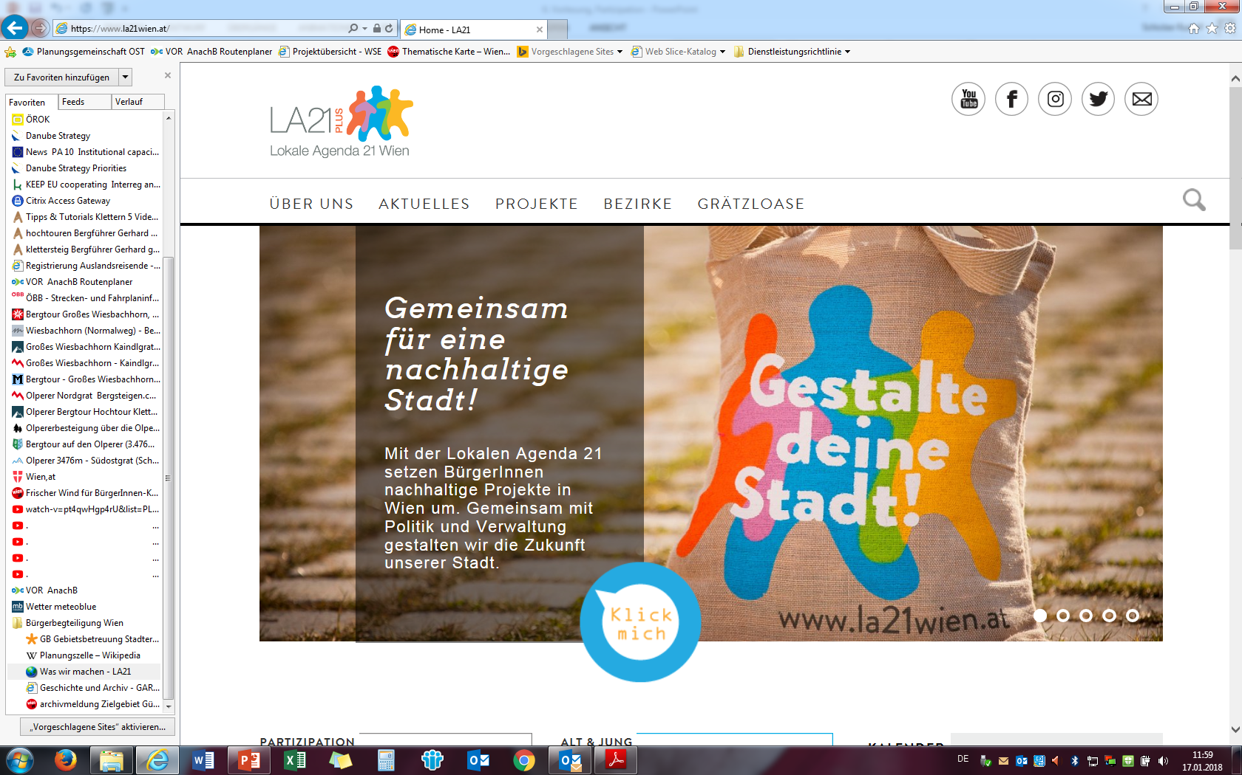
EUROPEAN UNION

Slide 21
EUROPEAN UNION
Remarks to the Recommendation

Slide 22



EUROPEAN UNION
Thank you for your attention!
Priority Area 10 | Institutional Capacity and Cooperation
Rudolf Schicker PA10 Coordinator - EUSDR
Kirchberggasse 33-35/9
A - 1070 Wien
Tel: +43 (1) 89 08 088 2201
Rudolf.Schicker@pa10-danube.eu
With the financial support of the European Union
www.danube-capacitycooperation.eu

