Slide 1
An Agenda for Regional Growth
www.rcc.int
Facebook.com/RegionalCooperationCouncil
Twitter.com/@rccint
YouTube.com/RCCSec
Gazmend Turdiu,
RCC Deputy Secretary General
Pristina, 23 October 2016

Slide 2
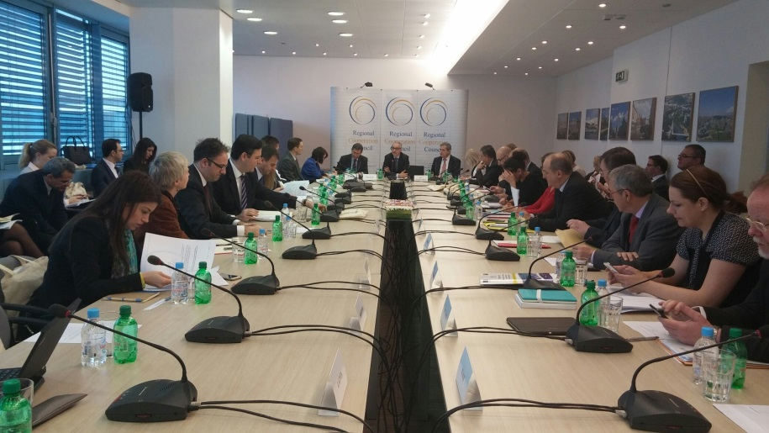
Who is RCC?
Mission: To promote European and Euro-Atlantic integration of South East Europe through regional cooperation
Launched at SEECP MFA meeting in Sofia, on 27 February 2008;
Successor of Stability Pact for South Eastern Europe;
All-inclusive, regionally owned and led framework;
Provides operational capacities to and works under political guidance of SEECP;
46 participants (25 board participants contributing to the RCC budget).

Slide 3

Areas of cooperation (RCC Statute)
  Economic and Social Development
  Energy and Infrastructure
  Justice and Home Affairs
  Security Cooperation
  Building Human Capital

Slide 4

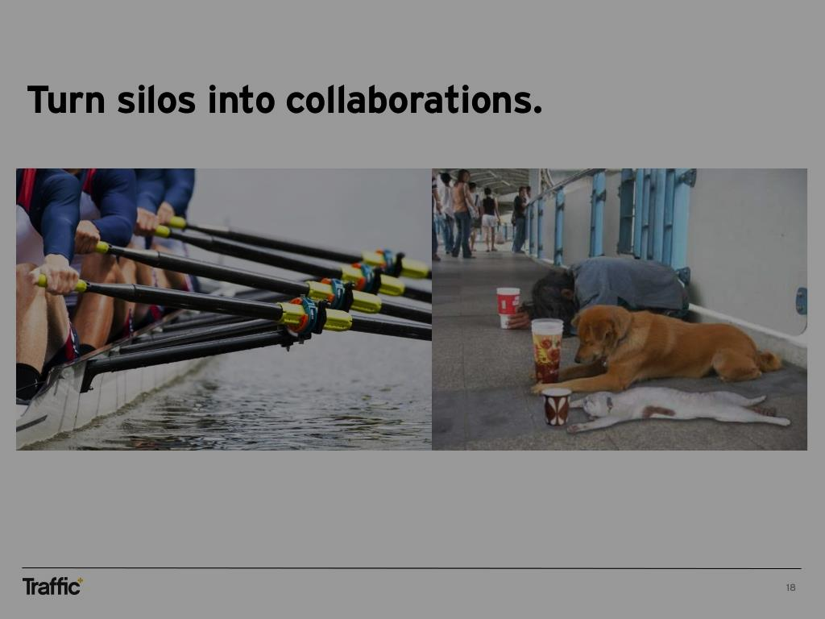
2008-13
2014-16
Extending Particip.
Budgeted: 5.8%
Stability and Rule of Law
Budgeted: 21.7%
Job-creating growth and
European integration
Budgeted :
72.3% of programme
culture
health
reconciliation
environment
Cross-Cutting Issues
JHA and
Security
SEE 2020
trade
building human capital
economic development
ICT cooperation
social development
security
transport
justice
energy

Slide 5
Balkan Barometer
What do you think are the two most important problems?

Slide 6
What has been achieved?
  SEE 2020 Int. Growth Pillar: Trade and investment integration in SEE/WB is increasing.
    Liberalization of trade in goods and agricultural products
    Agreement on accompanying measures to open markets and remove barriers.
    Negotiations on liberalization of trade in business and prof. services started (2015)
    Regional Investment Reform Agenda (RCC/WB/EU) launched
  SEE 2020 Smart Growth Pillar: Efforts to add value through better education, innovation
  and increased productivity still fledgling. Developments in this area include
    the formal establishment of the regional R&D center for innovation (WISE)
    and the Education Reform Initiative for South East Europe (ERI SEE)
    RCC: Completion of the Ljubljana Process II project
    (rehabilitation of cultural heritage, development of management plans)

Slide 7
What has been achieved?
  SEE 2020 Sustainable Growth Pillar: Berlin Process (2014), connectivity agenda
    Political backing for infrastructure development coupled with initial resources
    Agreement on the core transport network, connecting WB to the existing EU
    transport corridors (Mediterranean, Orient-East and Rhine-Danube).
    Priority transport and energy projects identified. Integration of power systems.
    RCC’s study on multi-modal transport, strengthening links within WB and beyond
  SEE 2020 Inclusive Growth Pillar: the focus on employment and mobility generated
  new initiatives.
    Structures to advance the agreed regional mobility agenda (Joint Working Group on
    Recognition of Professional Qualifications RCC/CEFTA/ERI-SEE) already in place
    RCC’s Employment and Social Affairs Platform (RCC-ILO)

Slide 8
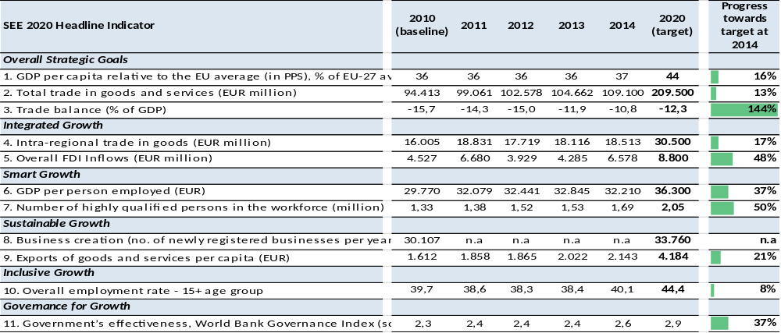
Progress towards SEE 2020 Regional Headline Targets

Slide 9
Main objectives for the future (RCC-SWP 17-19)
  Reduce and – where possible – remove the obstacles to increased
  mobility, enhanced connectivity and improved competitiveness in SEE
  Contribute to better governance, improved functioning of the Rule
  of Law, and enhanced security in SEE
  Expand the scale and geographical scope of interventions in SEE

Slide 10
The future focus of RCC’s work
  Implementation of the SEE 2020 Strategy (Skills and Mobility,
  Connectivity, Competitiveness)
  Support to Good Governance, Rule of Law, and Security Cooperation
    PAR, Justice, Anticorruption, Organized Crime, Security Challenges
  Horizontal and supporting activities
    Strengthening between SEE governments and the EU
    Supporting and streamlining the regional cooperation structures
    Broadening links and strengthening partnership with other regional
    stakeholders (including media and civil society)

Slide 11



Implementing SEE 2020 through flagship approach
A.1 Skills & Mobility
A.2 Competitiveness
A.3 Connectivity
2016:
Start of negotiations
integrated growth
smart growth
sustainable growth
inclusive growth
governance for growth

Slide 12
Example: reducing roaming costs in the WB
Problem:
Up to 8x higher roaming costs than in the EU; 55% of businesses complain about roaming charges
Intervention:
Regional roaming agreement
Result:
Up to 30% lower costs for consumers
Next steps:
Ensure implementation beyond 2017, expand geographic scope
Extending Particip.
Strengthened parliamentary dimension related to EU acquis and SEE 2020
Increased involvement and consultations with civil society in regional actions
Stability and Rule of Law
Regional judicial cooperation established (training, mediation)
Corruption proofing and risk assessment implementation
FTF and CVE platform
Job-creating growth and
European integration
Intra-regional mobility – sectors and professions agreed
Connectivity – communication costs within region reduced
Economic corridors linking trade, transport and industry identified
Regional investment agenda agreed
Open Access – access to publicly-funded research by 2020

Slide 13
Risks and constrains
  Political commitment and support
  Capacity of governments to implement and coordinate nationally
  Reduced availability of funding and shift in allocation priorities

Slide 14

Thank you!
Regional Cooperation Secretariat
Trg Bosne i Hercegovine 1/V
71000 Sarajevo, Bosnia and Herzegovina
Tel: +387 33 561 700
Fax: +387 33 561 701
Mob: +387 61 190 601
www: rcc.int
Twitter: @rccint
Facebook: RegionalCooperationCouncil
YouTube: RCCSec

